Slide 1
PAVING A PATH FOR HUMAN CENTERED COMPUTING
Presented By Poojal Katiyar (220770)
JAMES LANDAY
STANFORD HAI CO DIRECTOR

Slide 2
Background: JAMES LANDAY
James Landay was inspired by his father’s struggle with computers to create intuitive, user-friendly technology. He focused on end-user programming, helping people interact with computers without coding knowledge. His dissertation tool, SILK, encouraged creative sketching for interface design. He developed DENIM for sketching websites and co-founded NetRaker to improve web design. At the University of Washington, he designed UbiFit, a device that tracked exercise and promoted goal achievement. His work has had a lasting impact on user-centered design and interactive technology.

Slide 3
What is human centered AI?
It requires considering how AI impacts users, communities, and society. Landen advocates for a design process that integrates these concerns from the beginning to avoid negative societal impacts.“AI is going to impact everything in society: our schooling, our health, our environment, our politics, all of it,” he says. “And I believe HAI is in the right place to help guide AI toward having a positive impact rather than a negative one.”

Slide 4
Ubiquitous computing
Landay’s work in ubiquitous computing focused on embedding technology into everyday objects. At Intel Labs, his team developed an ambient healthcare system for aging adults, using RFID bracelets to track movements and interactions with household items. They applied machine learning to recognize activities, like brushing teeth. Also in collaboration with Billington, he continues working with ubiquitous computing as part of a project to develop healthier hybrid digital-physical spaces.

Slide 5
AI faces issues in balancing idealized technological applications with real-world complexity.
Critique and Ethical Oversight: AI beforehand cannot catch issues, therefore it does not help in early detection.The goal should be to design AI with built-in ethical considerations, creating solutions that are proactive in preventing harm.
Naive Technological Approaches: Technologists may identify areas (like health or education) where AI can have a positive impact but may overlook the complexities of real-world application. As the example of AI in radiology and skin cancer detection shows, the gap between training algorithms on perfect data sets and deploying them in the real world with imperfect, noisy data often leads to failure.

Slide 6
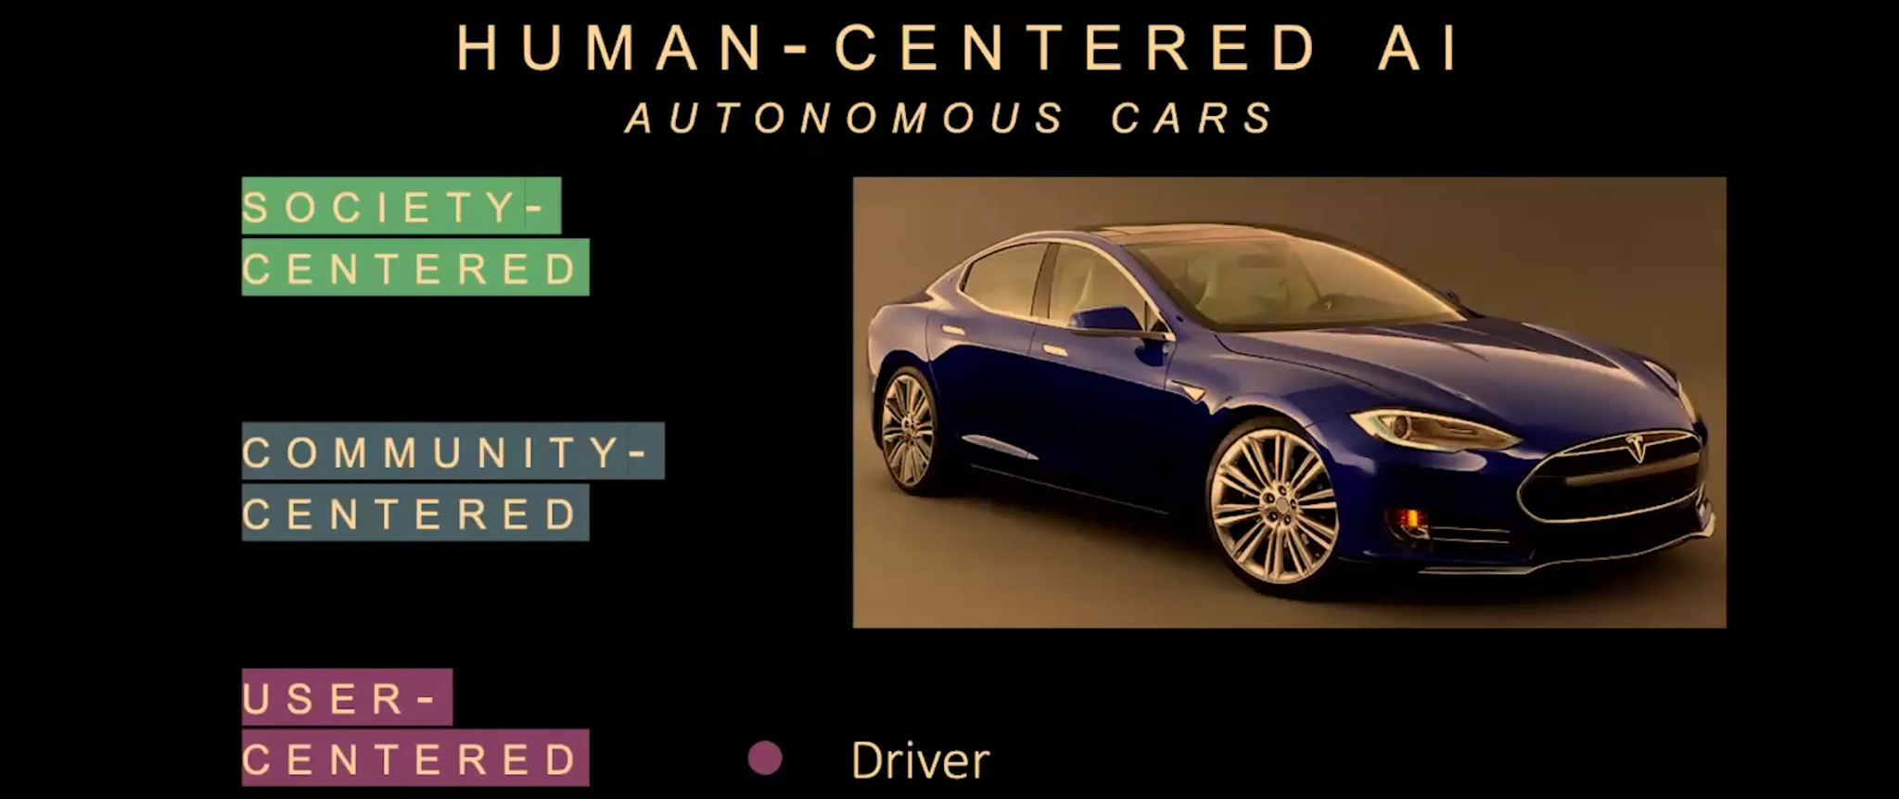
Human Centered AI Analysis on Automated Car using Tesla's autopilot feature as an example.
Self-driving cars, like Tesla’s Autopilot or Full Self-Driving (FSD), are becoming more advanced. However, the question is not just about making cars autonomous, but about how they impact people and society. Most research on autonomous vehicles has focused on technical capabilities (e.g., making self-driving work in different conditions). But a human-centered AI approach asks for more.

Slide 7
User Centered Analysis
Community Centered Analysis
Society Centered Analysis
The primary focus of most current autonomous car research has been on the user level, specifically designing systems that improve the user experience. This focus is important, but it’s not sufficient.
Autonomous car systems should also account for how other drivers, pedestrians, and cyclists interact with self-driving cars. Research has shown that people behave differently when they encounter an autonomous car. For example, one tragic incident involved an autonomous car not recognizing a person walking a bicycle
At the societal level, autonomous cars could have broad impacts, such as increased traffic and changes in driving patterns. For example, people might use autonomous cars to travel longer distances or send their cars on empty trips, which could lead to more congestion

Slide 8
Hybrid Physical-Digital Spaces to improve well being experiment
The motivation for this project was that many Americans are overstressed, inactive, wasteful, uninspired, and feeling isolated in their works or in their schools. And we wanted to really understand how do features of the building environment such as materials access to light or nature as well as the user experience. So, for example, the noise or dynamic digital displays on the wall. How do those features impact people's well being? How to redesign spaces that count for those understanding. And then from the H. C. I. Part how do we design systems that can sense our afflictions and dynamically adjust spaces to help improve our health and wellness?

Slide 9
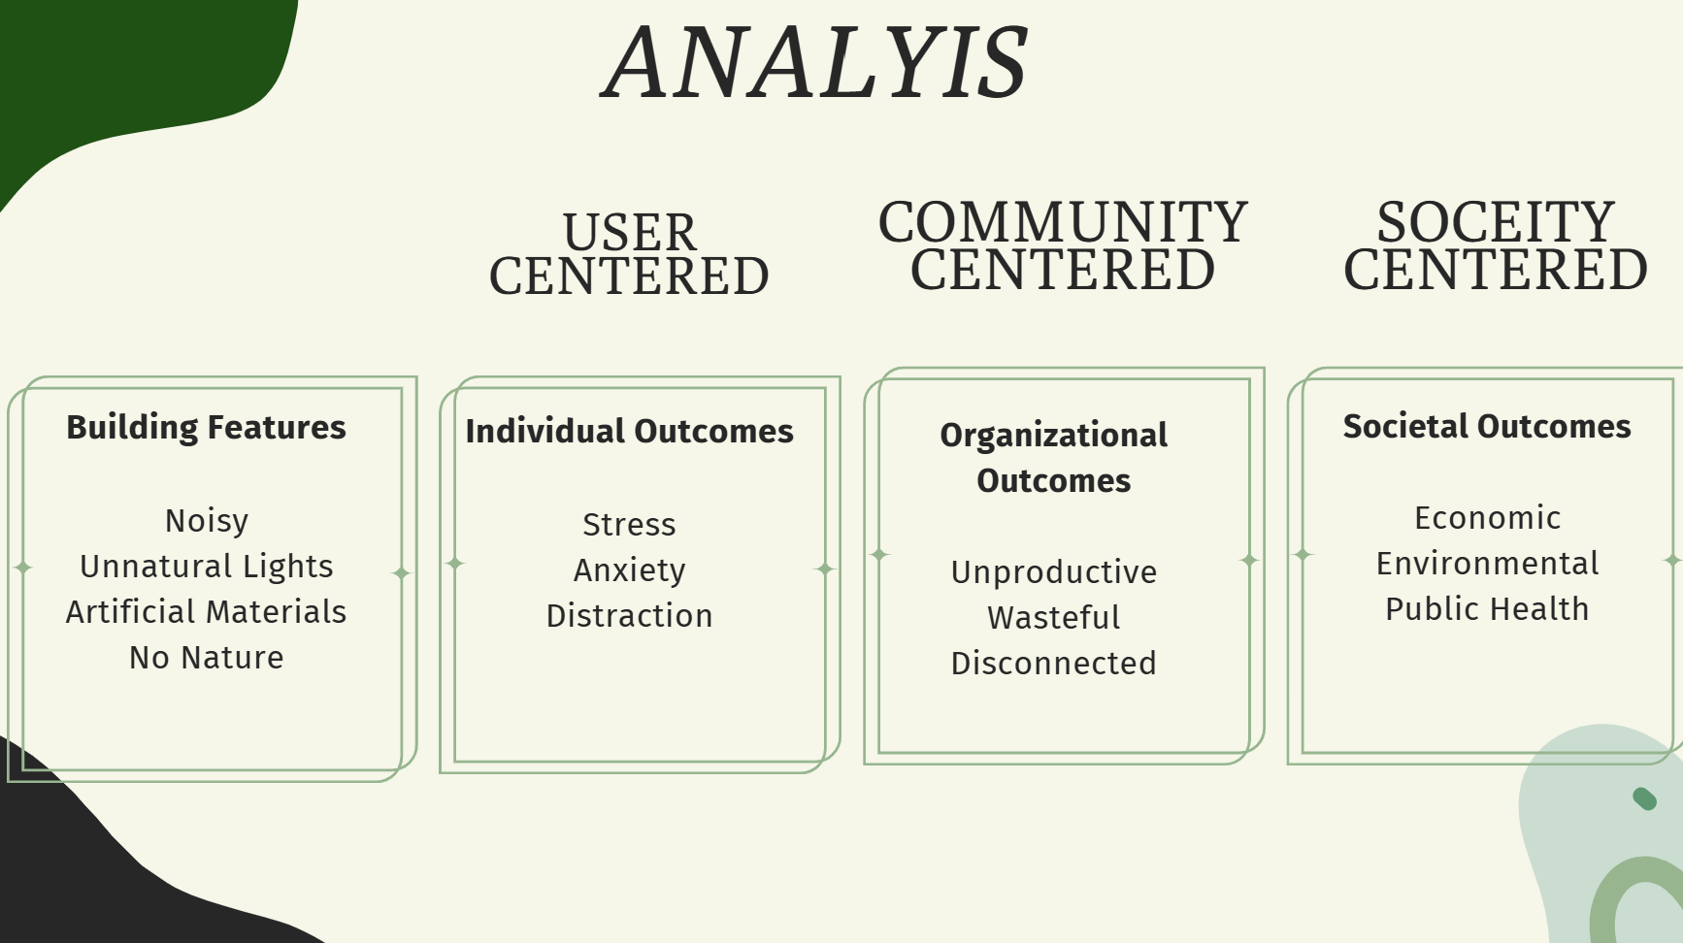

Slide 10
Started with a strong interdisciplinary team that includes computing, psychology, health, privacy and law, education and organizational behavior from the very start.
We looked at the user level problems like Noise levels, lighting, materials, and access to nature impact stress, anxiety, and focus. These, in turn, can lead to community outcomes, such as a lack of productivity. Finally, these community outcomes can impact our well-being at the societal level. We were thinking about these three levels a bit from the start
We established key steps to creating buildings that support our well being:
Establish the Science
Design Adaptations to support well being
Understand Privacy Constraints

Slide 11
EXPERIMENT
Conducted a year-long controlled lab experiment with 400+ participants in a real space on campus. Created two identical rooms and systematically varied building features:
Furniture: Natural vs. artificial materials.
Lighting: Natural vs. artificial light (built a wall to block windows in one room).
Images on walls: Showed either non-diverse (all white males) or diverse (race and gender) individuals.
Key Findings
Natural materials (wood furniture) had a stronger impact on reducing stress than expected, even more than natural light.
Extend studies to long-term, real-world environments rather than short lab sessions.

Slide 12
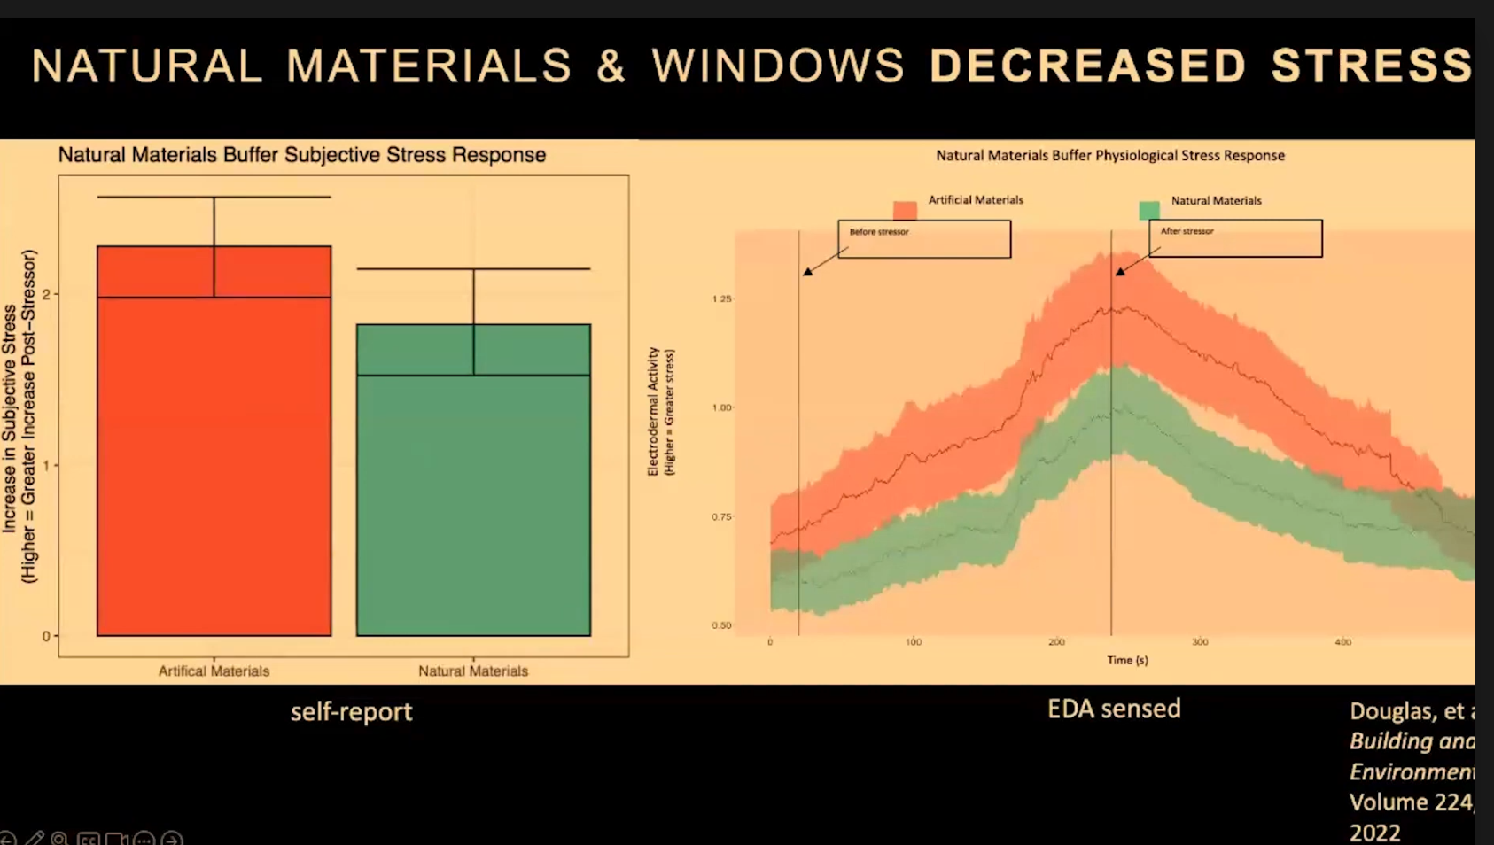

Slide 13
Need automated, sophisticated data collection to replace constant surveys. We collected data from surveys, etc and collection was opt in for security reasons. Then used AI to measure wellbeing outcomes. User Concerns over data collection and data security is legitimate.
The research on smart buildings aims to enhance human well-being by using AI and sensors to monitor factors like stress, belonging, and creativity. However, early studies primarily focused on individual benefits, with less attention given to broader societal implications such as privacy risks and community dynamics. A major concern is data collection, where users need transparency about what is being tracked, control over their data through opt-in mechanisms, and safeguards against potential surveillance misuse. Additionally, traditional privacy policies are ineffective, as they are often too complex and legalistic. Instead, users require clear and intuitive ways to understand how their data is being used in smart spaces.

Slide 14
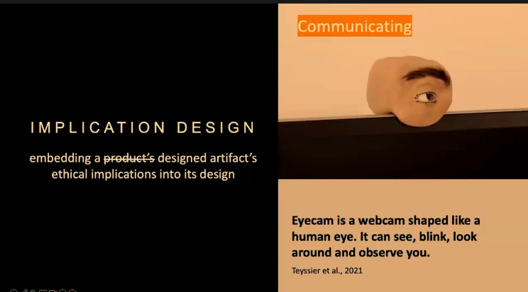
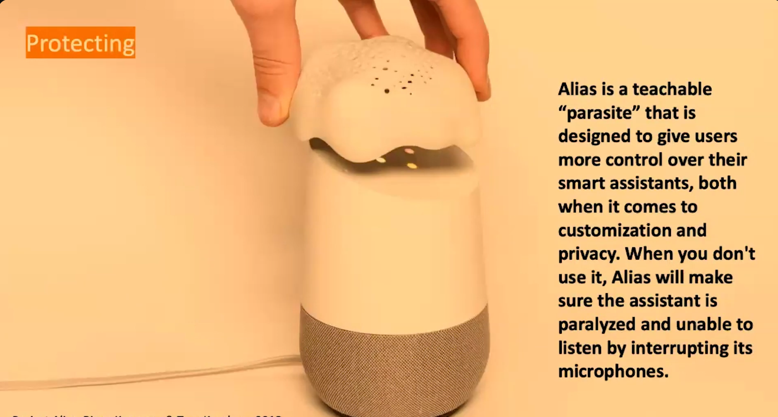
Solution 1 :Implication Design
(Embedding ethical considerations into product design )

Slide 15
Solution 2 :Workshops
The workshop design process aimed to engage diverse participants in identifying risks, proposing solutions, and exploring the ethical implications of AI in smart buildings. It was structured in three rounds:
Anticipation Round: Participants speculated on potential situations involving data collection and AI in smart buildings, considering both positive and negative impacts on users.
Implication Design Round: Participants prototyped designs to address the identified negative implications, focusing on privacy, security, and user control.
Action Round: Participants tested their designs through role-playing, posing threats and using their prototypes to counter them.
Workshop Outcomes included several experience prototypes meant to spark further discussion on privacy and user agency,

Slide 16

Uncertainty Communicator: Displays the uncertainty of AI's inferences.
Anonymity Bracelet: A wearable device that anonymizes data for privacy control.
Security Devices: Prototypes like a doorway device for detecting theft or a breathing regulation button for calming panic attacks.

Slide 17
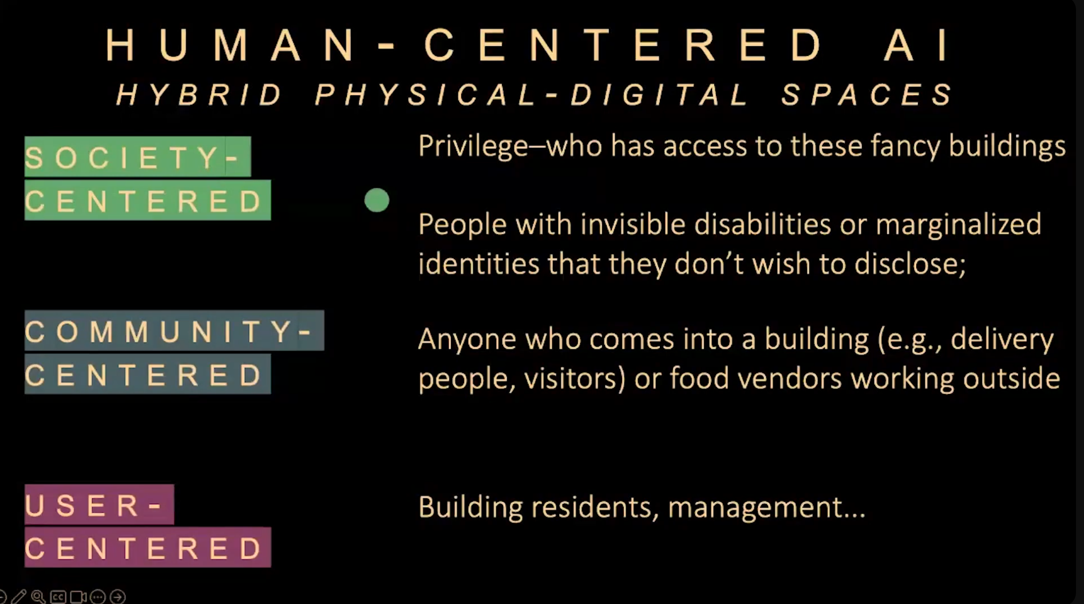

Slide 18
Conclusion
The shift from user-centered to community- and society-centered AI is essential for creating ethical, fair, and inclusive technology. It challenges the traditional tech industry mindset, which often focuses only on direct users while ignoring wider social impacts.

Slide 19
Thank You!
Reference:https://engineering.stanford.edu/news/james-landay-paving-path-human-centered-computing

